Slide 1
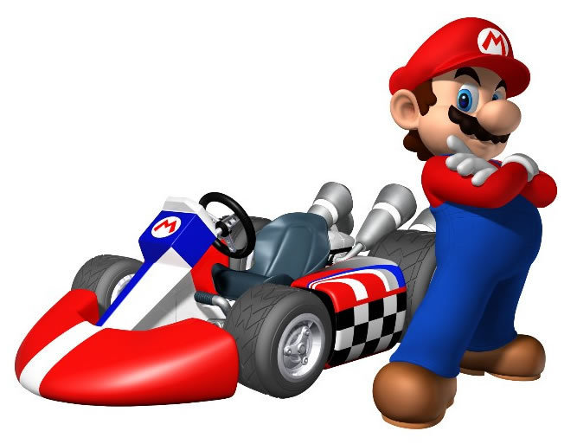
Final Project: Lego Mario Kart
Michael Ru
Yongxuan Li
Kevin Huo
Sachin Apiah

Slide 2

Problem Statement
Lack of entertainment value after building LEGO
No immersive game like experiences
Lack of RC (remote controlled) cars which can do more than just move

Slide 3
Constraints
Sensor usage
Intuitive Movement
Fluidity
Mechanical reaction to environment
Experience
Interactivity
Mechanically stable
Mechanically diverse
Notes:
go through each constraint and define and explain

Slide 4
Criteria
Aesthetic quality
Consistency
Building difficulty
Efficient usage of parts
Difficulty of user interaction
Resemblance to Mario Kart
Notes:
define and explain each criterion

Slide 5
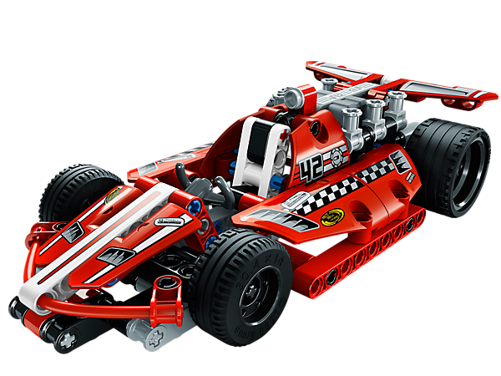
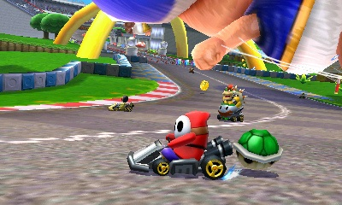
Solution
Racecar (LEGO NXT, Bluetooth connected to Wii remote)
Racetrack (coloured power-ups and obstacles)
Notes:
Our solution is to create a racing game simulation system using the LEGO NXT robots. This game will include add-ons such as power-ups and shooting.

Slide 6
Proposed Mechanical Designs

Slide 7
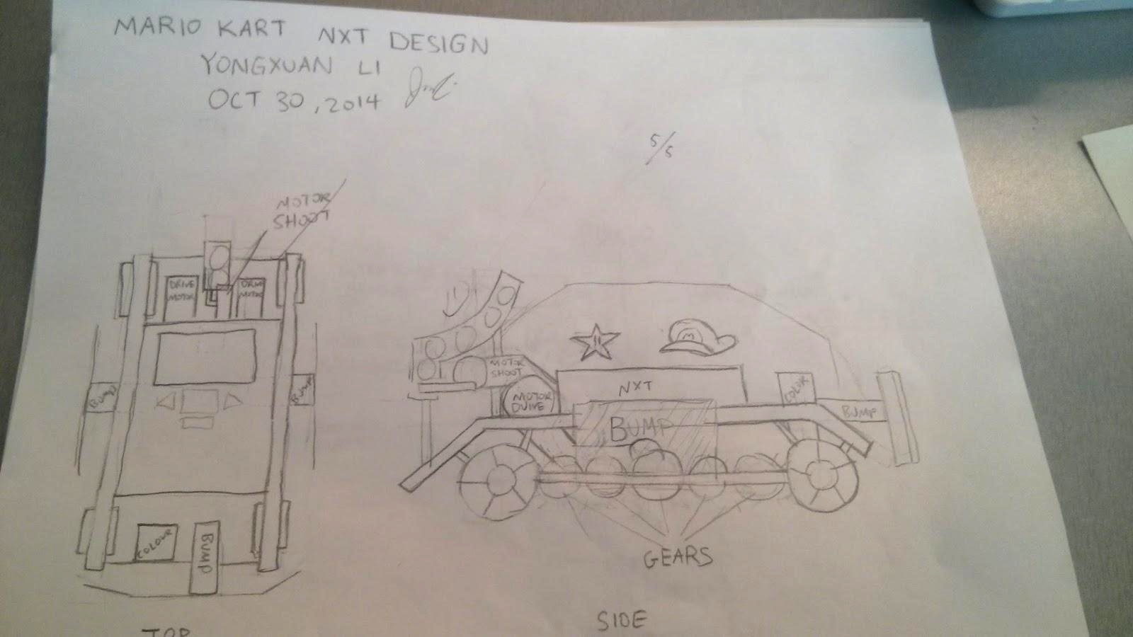

Slide 8
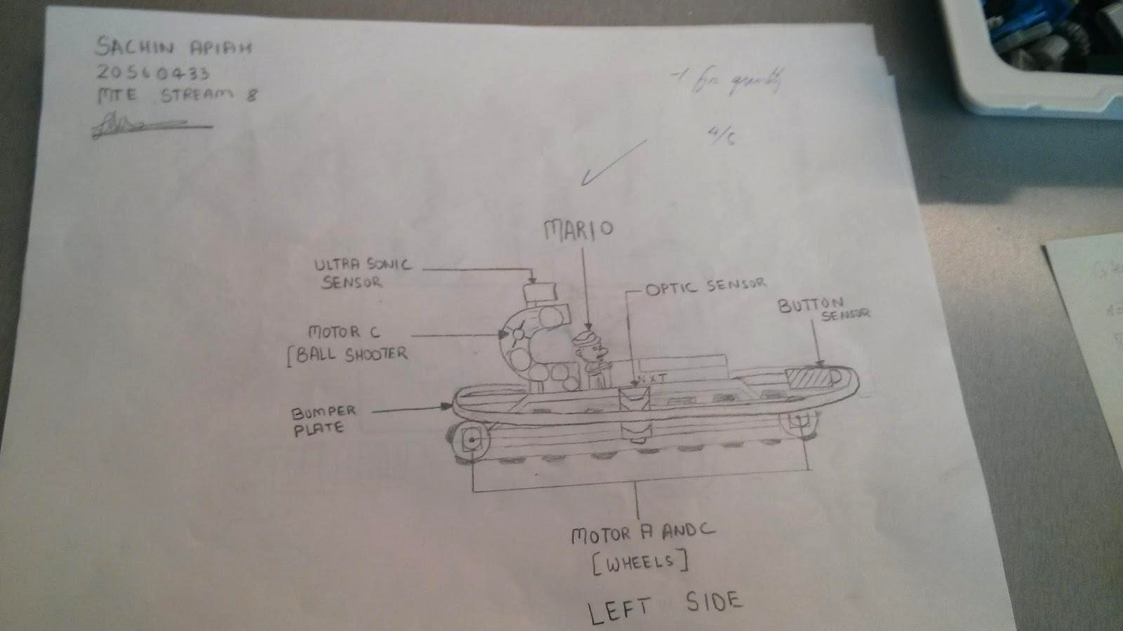

Slide 9
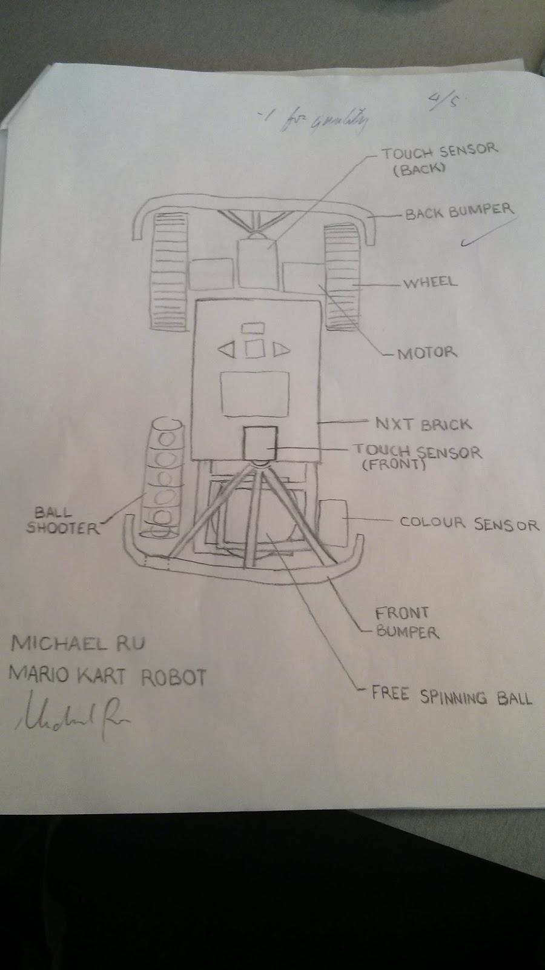

Slide 10
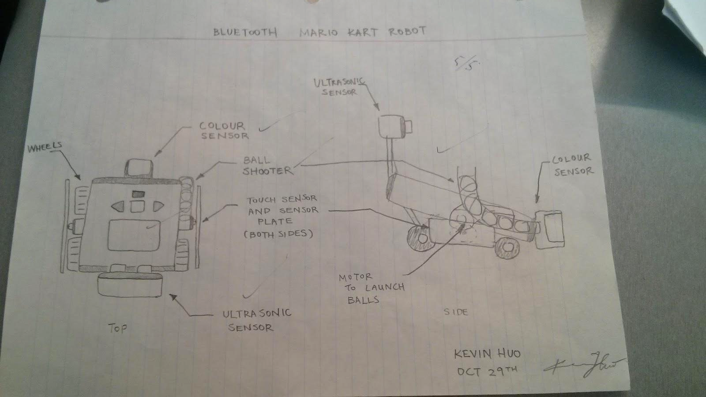

Slide 11
Decision Matrix - Tabulated Design Criteria
Criterion | Design 1 | Design 2 | Design 3 | Design 4
Mobility | 2 wheels connected by gears to a motor, with 2 motors | 2 wheels + 2 free wheels (using caterpillar tracks) | 2 wheels + free spinning ball | 2 wheels + 2 free wheels front wheel drive
Ease of build | Medium - hard | Medium - Hard | Medium | Easy- Medium
Appeal | Good | Good | Acceptable | Non-appealing
Additional Capabilities | Acceptable | Good | Acceptable | Good
Notes:
explain the reasoning behind each criteria
briefly go over each design

Slide 12
Mapped Ratings
Criterion | Design 1 | Design 2 | Design 3 | Design 4
Mobility | 0.6 | 0.5 | 0.8 | 0.5
Ease of build | 0.4 | 0.4 | 0.5 | 0.8
Appeal | 0.8 | 0.8 | 0.6 | 0.2
Additional Capabilities | 0.4 | 0.6 | 0.4 | 0.6
Notes:
highlight the pros of each design

Slide 13
Relative Importance
Criterion | Mobility | Ease of Build | Appeal | Additional Capabilities | Row Total | Normal Rating
Mobility |  | 1 | 1 | 1 | 3 | 0.5
Ease of Build | 0 | - | 0 | 1 | 1 | 0.166
Appeal | 0 | 1 | - | 1 | 2 | 0.333
Additional Capabilities | 0 | 0 | 0 | - | 0 | 0

Slide 14
Decision
Design 3 best satisfies the scaled ratings of the criteria.
Very mobile
Free moving ball provides more fluid movement
Encorporates all compents/sensors
Design is appealing and looks like a “kart”
Interface is easily accessable to the user
The design is not too difficult to build with the given parts
Notes:
Briefly explain and discuss possible changes to the selected design

Slide 15
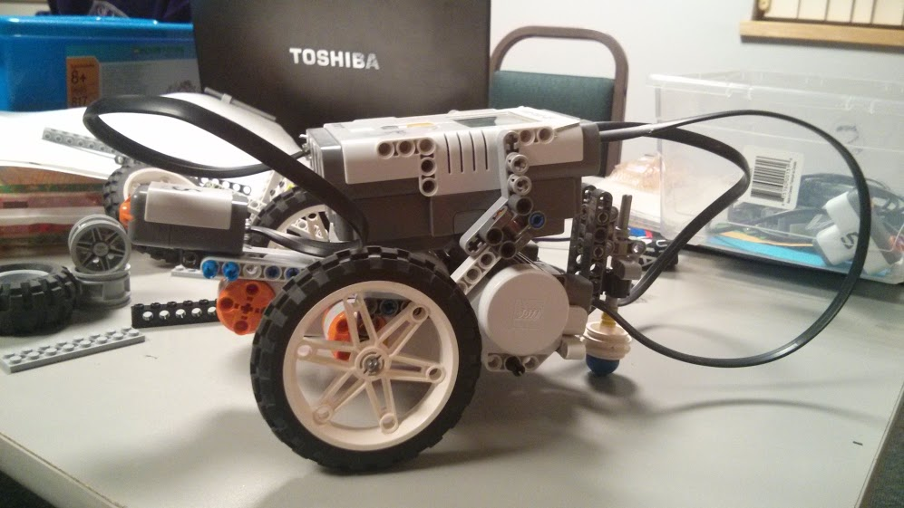
Prototype Design

Slide 16
Possible Changes
Motor controlled wheels should be in the front
Add more aesthetically pleasing components
Add extra supports to maintain rigidity
Obtain a larger free spinning ball

Slide 17
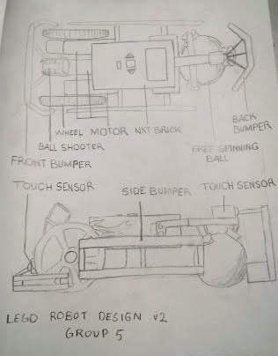
Robot Design v2

